Slide 1
Chapter One
Marketing: Creating and Capturing Customer Value

Slide 2
Creating and Capturing Customer Value
Topic Outline
What Is Marketing?
Understand the Marketplace and Customer Needs
Designing a Customer-Driven Marketing Strategy
Preparing an Integrated Marketing Plan and Program
Building Customer Relationships
Capturing Value from Customers
The Changing Marketing Landscape
Helpful URLS
http://www.learnmarketing.net/
www.marketingteacher.com/
https://www.youtube.com/watch?v=lwea5wpZTcY
https://www.youtube.com/watch?v=3PA29gqZijM

Slide 3
What Is Marketing?
Marketing is the process by which companies creates value for customers and build strong customer relationships in order to capture value from customers in return.

Slide 4
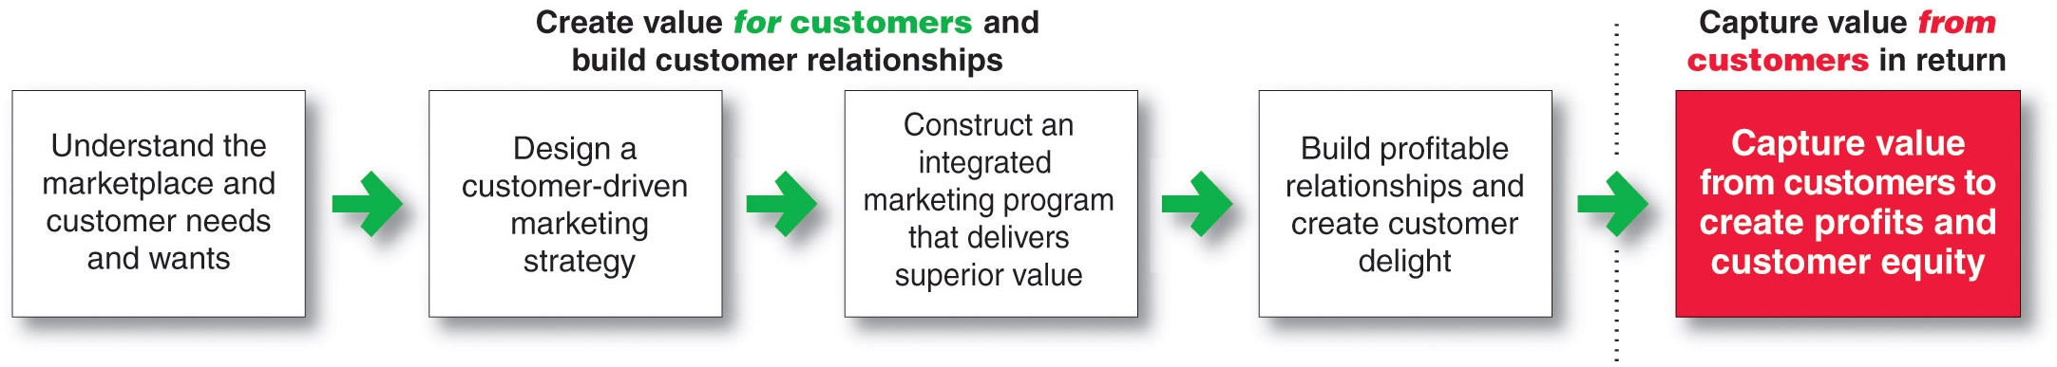
What Is Marketing?
The Marketing Process

Slide 5
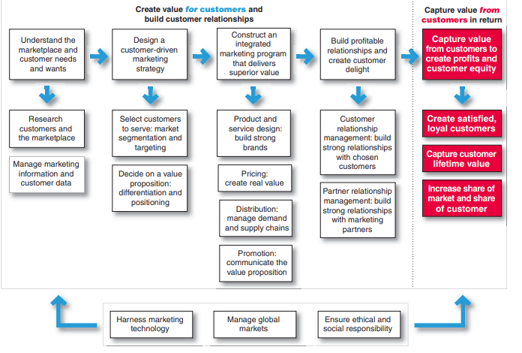

Slide 6
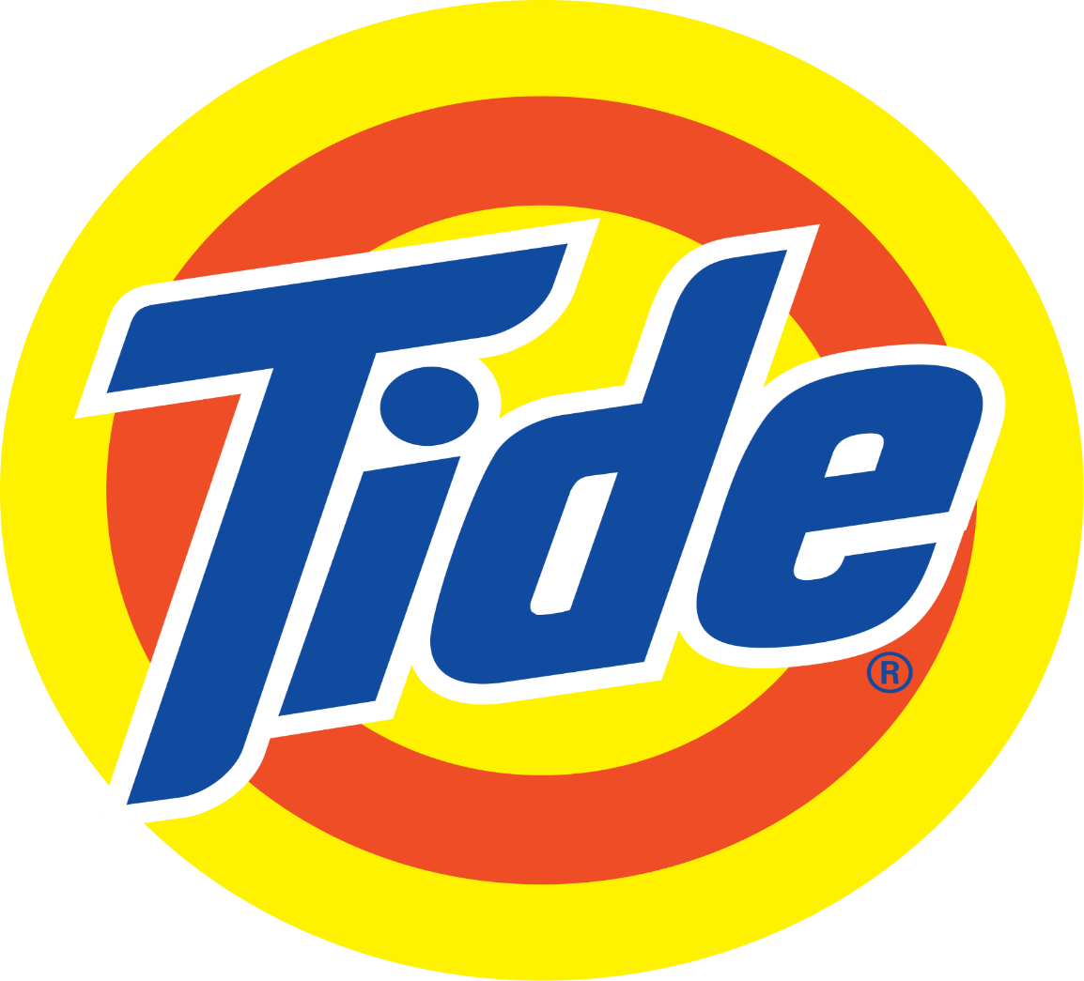
Its not about telling and selling , its about bringing a customer relationship mindset to everything we do..

Slide 7
Understanding the Marketplace and Customer Needs
Core Concepts
Customer needs, wants, and demands
Market offerings
Value and satisfaction
Exchanges and relationships
Markets

Slide 8
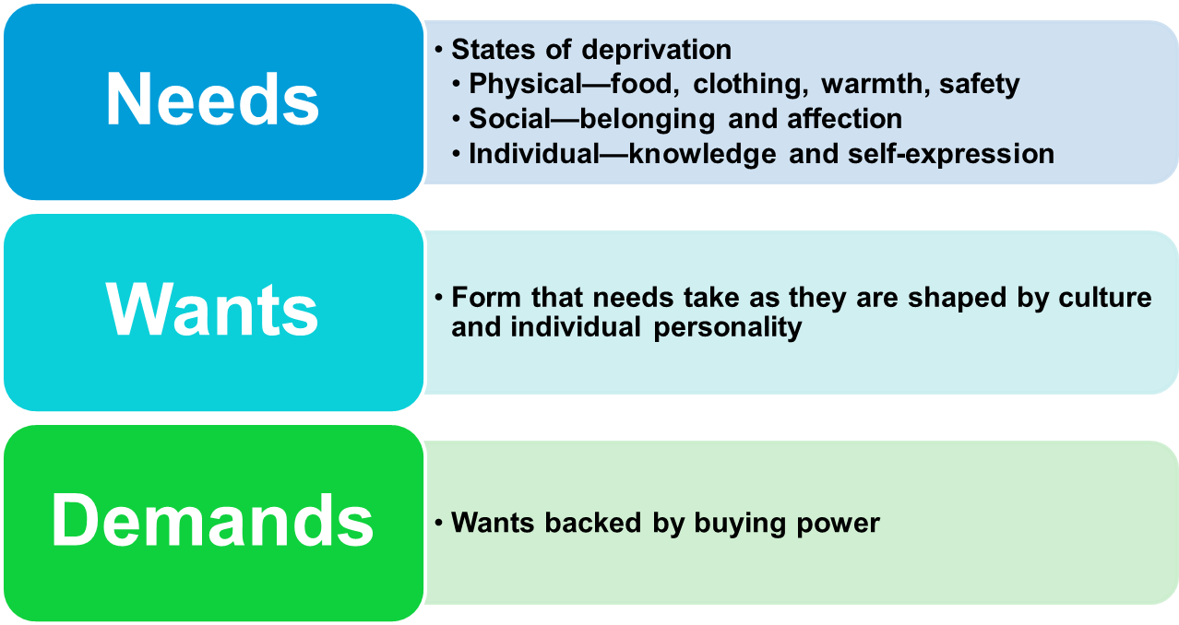
Understanding the Marketplace and Customer Needs
Customer Needs, Wants, and Demands

Slide 9
Understanding the Marketplace and Customer Needs
Market offerings are some combination of products, services, information, or experiences offered to a market to satisfy a need or want.
https://www.youtube.com/watch?v=Op6k4AwSamo
https://www.youtube.com/watch?v=beB249dZFlQ
Marketing myopia is focusing only on existing wants and losing sight of underlying consumer needs.
https://www.youtube.com/watch?v=Aq2dkHCDHfA

Slide 10
Understanding the Marketplace and Customer Needs
Exchange is the act of obtaining a desired object from someone by offering something in return

Slide 11
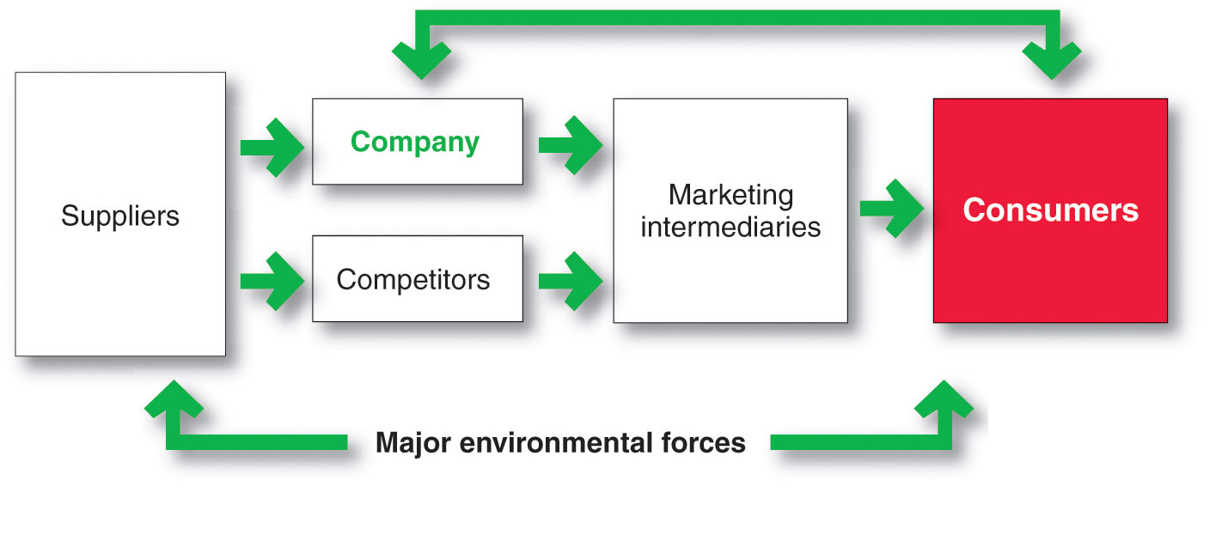
Understanding the Marketplace and Customer Needs
Markets are the set of actual and potential buyers of a product

Slide 12
Designing a Customer-Driven Marketing Strategy
Marketing management is the art and science of choosing target markets and building profitable relationships with them
  What customers will we serve?
  How can we best serve these customers?

Slide 13

Designing a Customer-Driven Marketing Strategy
Selecting Customers to Serve
Market segmentation refers to dividing the markets into segments of customers
Target marketing refers to which segments to go after

Slide 14
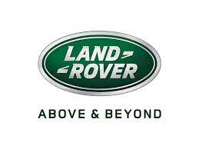

Designing a Customer-Driven Marketing Strategy
Choosing a Value Proposition
Land Rover Lets you ‘Go Beyond’ - to get a taste of adventure, whatever your tastes.

Slide 15
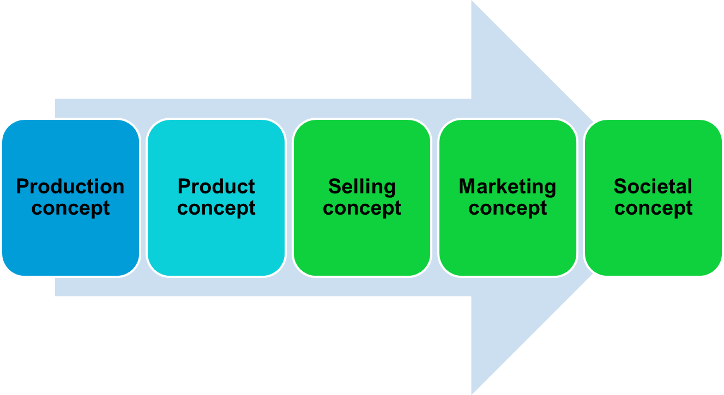
Designing a Customer-Driven Marketing Strategy
Marketing Management Orientations

Slide 16
Designing a Customer-Driven Marketing Strategy
Marketing Management Orientations
Production concept is the idea that consumers will favor products that are available or highly affordable

Slide 17
Designing a Customer-Driven Marketing Strategy
Marketing Management Orientations
Product concept is the idea that consumers will favor products that offer the most quality, performance, and features. Organization should therefore devote its energy to making continuous product improvements.
https://www.youtube.com/watch?v=NrmMk1Myrxc

Slide 18
Designing a Customer-Driven Marketing Strategy
Marketing Management Orientations
Selling concept is the idea that consumers will not buy enough of the firm’s products unless it undertakes a large scale selling and promotion effort

Slide 19
Designing a Customer-Driven Marketing Strategy
Marketing Management Orientations
Marketing concept is the idea that achieving organizational goals depends on knowing the needs and wants of the target markets and delivering the desired satisfactions better than competitors do.
https://www.youtube.com/watch?v=IY4x85zqoJM

Slide 20
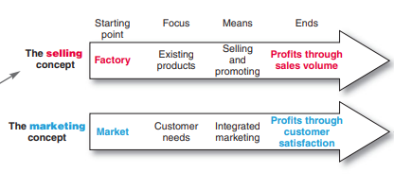

Slide 21
Designing a Customer-Driven Marketing Strategy
Marketing Management Orientations
Societal marketing concept is the idea that a company should make good marketing decisions by considering consumers’ wants, the company’s requirements, consumers’ long-term interests, and society’s long-run interests

Slide 22
Preparing an Integrated Marketing Plan and Program
The marketing mix is the set of tools (four Ps) the firm uses to implement its marketing strategy. It includes product, price, promotion, and place.
Integrated marketing program is a comprehensive plan that communicates and delivers the intended value to chosen customers.

Slide 23
Building Customer Relationships
Customer Relationship Management (CRM)
The overall process of building and maintaining profitable customer relationships by delivering superior customer value and satisfaction.
https://www.youtube.com/watch?v=4YG0jI32K68

Slide 24
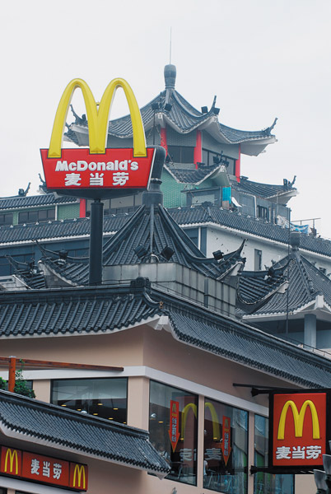
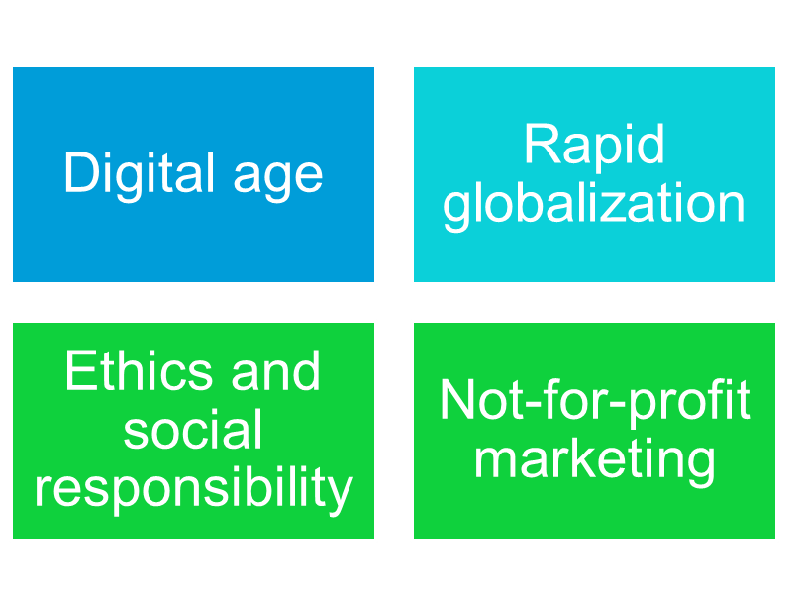
The Changing Marketing Landscape
Major Developments
https://www.youtube.com/watch?v=DOUkKwVyRDo
Notes:
Ramen Noodles, Italian Pasta, Dumplings etc.

Slide 25
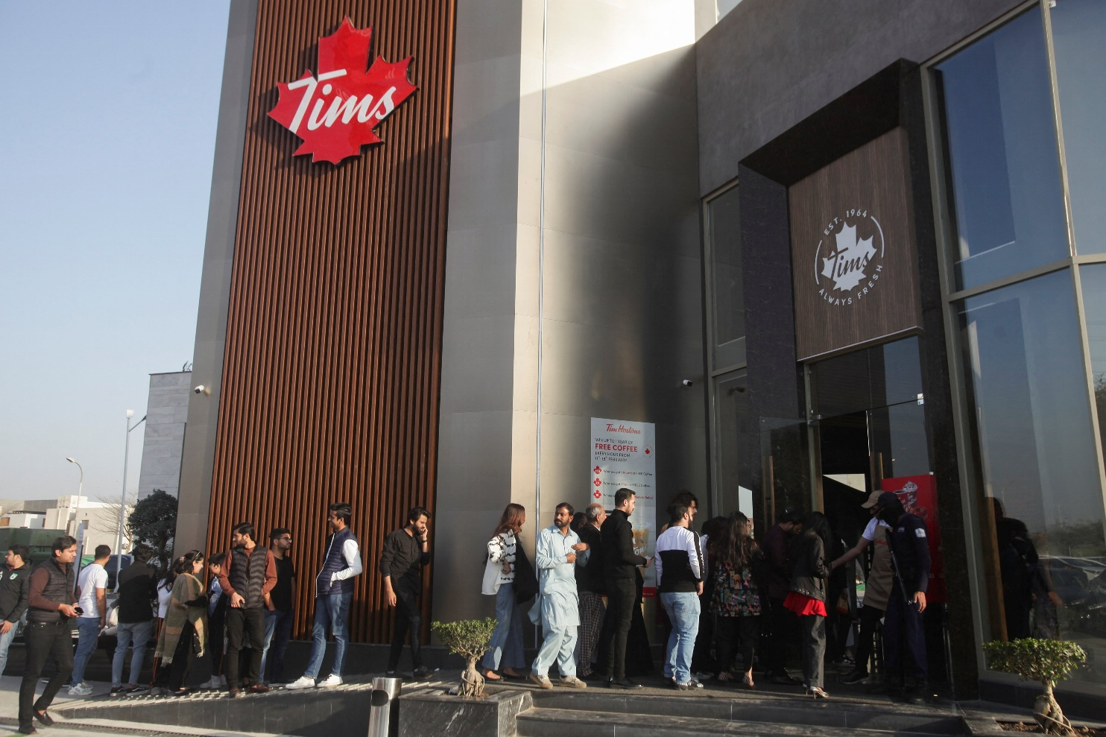
Tim Hortons Pakistan Launch

